Slide 1
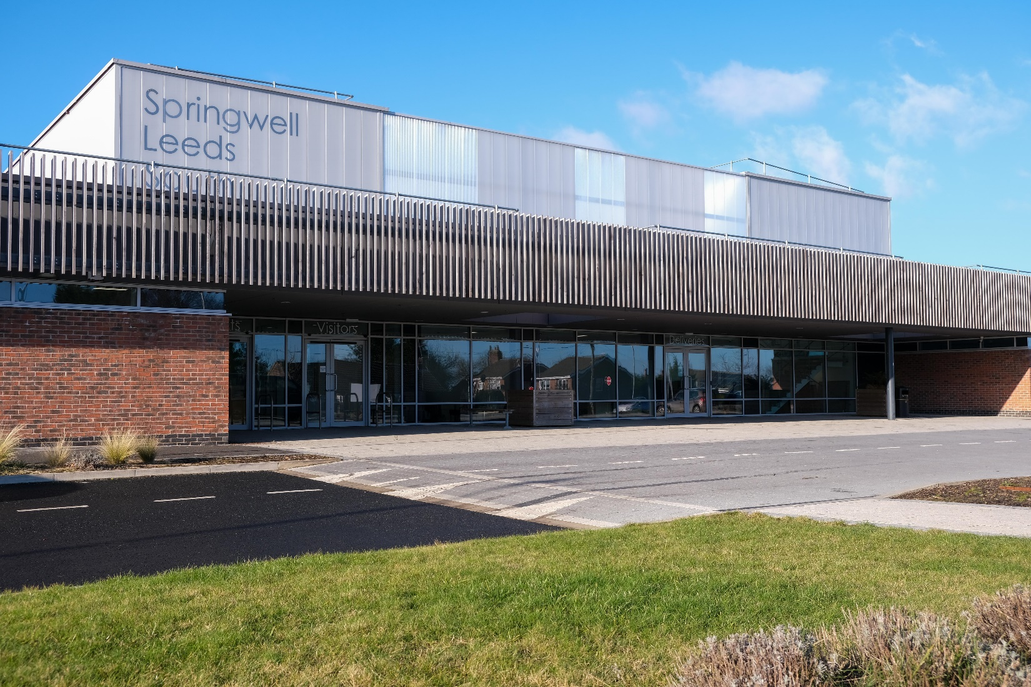
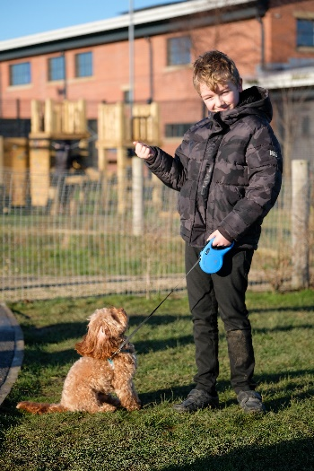
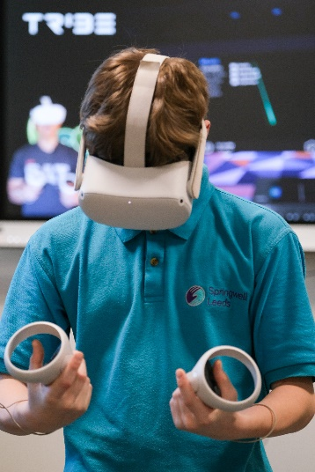
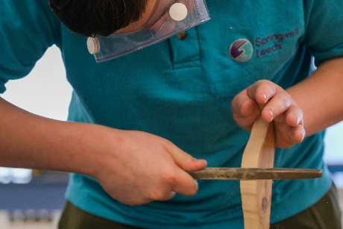
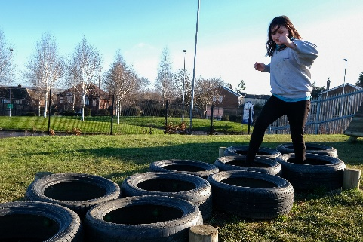
Current Vacancies
HLTA
Admin Assistant
Teaching Assistant
Care Team (Pastoral)
Recruitment Fair
Wednesday 29th June 2022
4pm–6pm
Springwell Academy East Site
Brooklands Drive, LS14 6SB
•Full-time job roles •Training opportunities • Careers advice
• Excellent career progression opportunities
•Come to see our state-of-the-art building and speak to experts about restorative practice, social emotional, mental health, and trauma informed approaches.
•Come and see how you could develop your knowledge and skills in these areas by joining our expert team.
Representatives will be on hand to assist with application forms, give general advice and to answer any questions.
For more information contact:
eastconcerns@springwellacademyleeds.org

